Slide 1
Pandas for Data Science

Slide 2
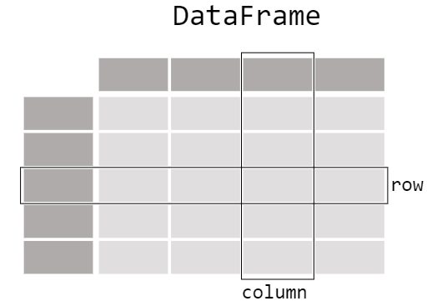

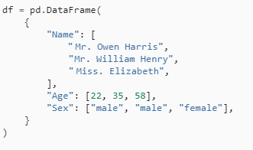
Pandas & DataFrame
A DataFrame is a 2-dimensional data structure that can store data of different types
(characters, integers, floating point values, categorical data and more) in columns.

Slide 3
Series
Interested in working with the data in the column Age
df["Age"]
When selecting a single column of a pandas DataFrame, the result is a pandas Series.
If you need to create a Series object
ages = pd.Series([22, 35, 58], name="Age")

Slide 4
Functions
I want to know the maximum Age of the passengers
  For DataFrame object : df["Age"].max()
  For Series object : ages.max()
Interested in some basic statistics of the numerical data of my dataFrame
df.describe()
Interested in some

Slide 5
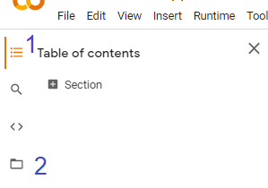
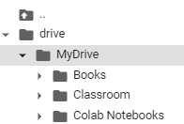
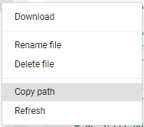
Connecting Colab with Google Drive
Access to Drive
  from google.colab import drive
  drive.mount ('/content/gdrive’)

Slide 6
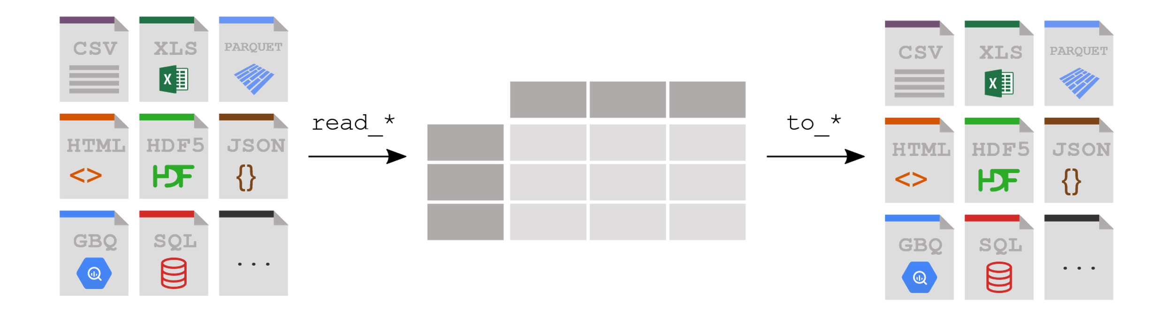
Read & Write Files using Pandas
titanic = pd.read_csv("titanicData.csv")
type(titanic)

Slide 7
Check - After Reading The Data
>> titanic
>> titanic.head()
>> titanic.head(10)
>> titanic.tail()
>> titanic.tail(10)
>> titanic.info()
>> titanic.shape
>> titanic.columns
>> titanic.dtypes

Slide 8
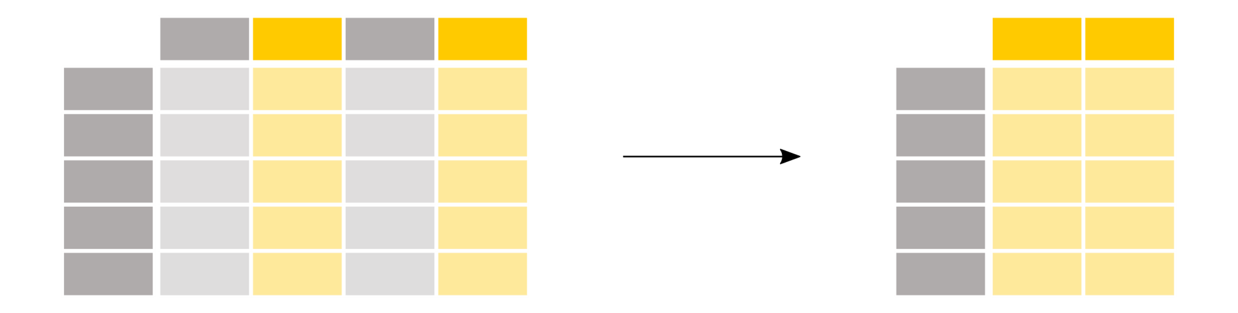
Subset of dATAFRAME
How to select specific columns from a DataFrame?
titanic["Age"]
titanic[["Age", "Sex"]]
type(titanic["Age"])
type(titanic[["Age", "Sex"]])

Slide 9
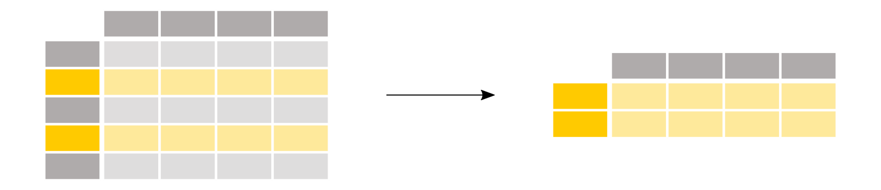
Subset of dATAFRAME
How to select specific rows from a DataFrame?
above_35 = titanic[titanic["Age"] > 35]
above_35.shape
above_35
The condition inside the selection brackets titanic["Age"] > 35 checks
“for which rows the Age column has a value larger than 35”:
titanic["Age"] > 35

Slide 10
More on Row Filtering
Passengers from cabin class 2 and 3
>> titanic[ titanic["Pclass"].isin( [2, 3] ) ]
  the condition inside the selection brackets titanic["Pclass"].isin([2, 3]) checks
  “for which rows the Pclass column is either 2 or 3”
>> titanic[ (titanic["Pclass"] == 2) | (titanic["Pclass"] == 3) ]
Passenger data for which the age is known
titanic[ titanic["Age"].notna() ]

Slide 11

select specific rows and columns from a DataFrame?
Names of the passengers older than 35 years
In this case, a subset of both rows and columns is required in one go
using selection brackets [] will not work
loc/iloc operators is used in front of the selection brackets []
titanic.loc[titanic["Age"] > 35, "Name"]
rows you want, columns you want to select

Slide 12
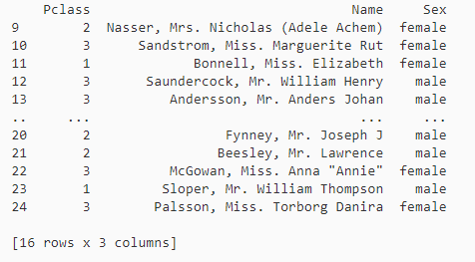
select specific rows and columns from a DataFrame?
Rows 10 till 25 and columns 3 to 5
titanic.iloc[9:25, 2:5]
Columns
Rows

Slide 13
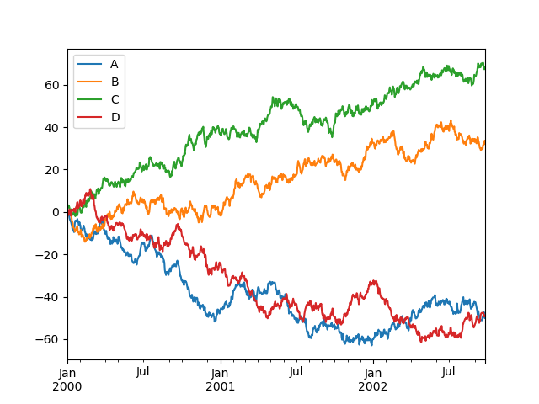
Data visualization
Matplotlib
>> import matplotlib.pyplot as plt
>> plt.close("all")
>> df = pd.DataFrame(np.random.randn(1000, 4), index=ts.index, columns=list("ABCD"))
>> df = df.cumsum()
>> plt.figure();
>> df.plot();
Error?

Slide 14
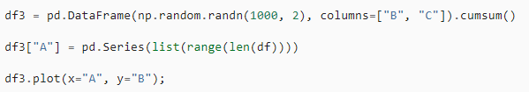

You can plot one column versus another using the x and y keywords in plot():
‘bar’ or ‘barh’ for bar plots ‘hist’ for histogram
‘box’ for boxplot ‘kde’ ‘density’ for density plots
‘area’ for area plots ‘scatter’ for scatter plots
‘hexbin’ for hexagonal bin plots ‘pie’ for pie plots

Slide 15

Plotting dataframe
Directly calling methods instead of passing argument kind
df3.plot.hist(alpha=0.5);
df3.plot.box()

Slide 16

CrEATING plots IN Pandas
air_quality = pd.read_csv ( "data/air_quality_no2.csv", index_col=0, parse_dates=True )
air_quality.head()
air_quality.plot()
air_quality["station_paris"].plot()
Notes:
https://pandas.pydata.org/docs/user_guide/visualization.html#visualization-other

Slide 17
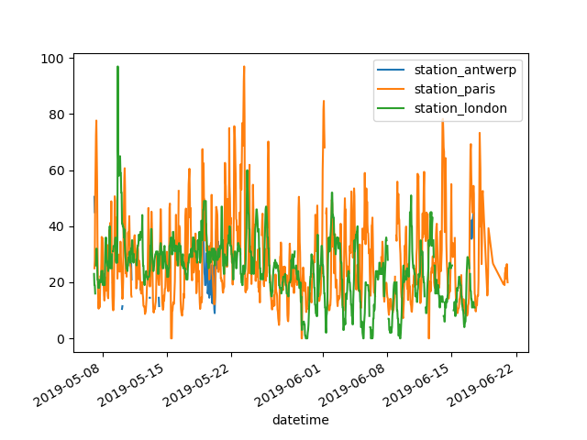

plots in pandas
>> air_quality.plot()
plot only the columns of the data table with the data from Paris
>> air_quality["station_paris"].plot()

Slide 18
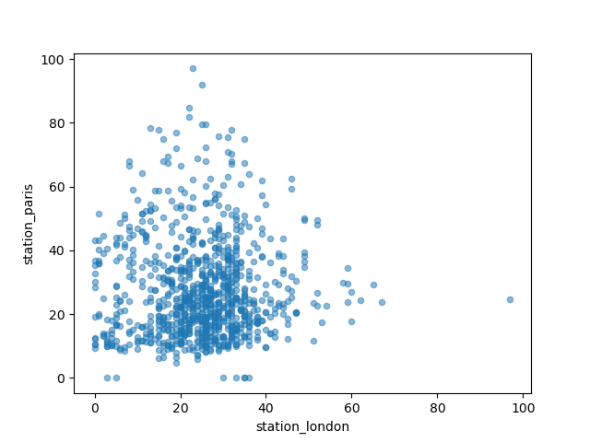
Plots in pandas
Visually compare the N02 values measured in London versus Paris
>> air_quality.plot.scatter(x="station_london", y="station_paris", alpha=0.5)
>> air_quality.plot.box()

